Slide 1


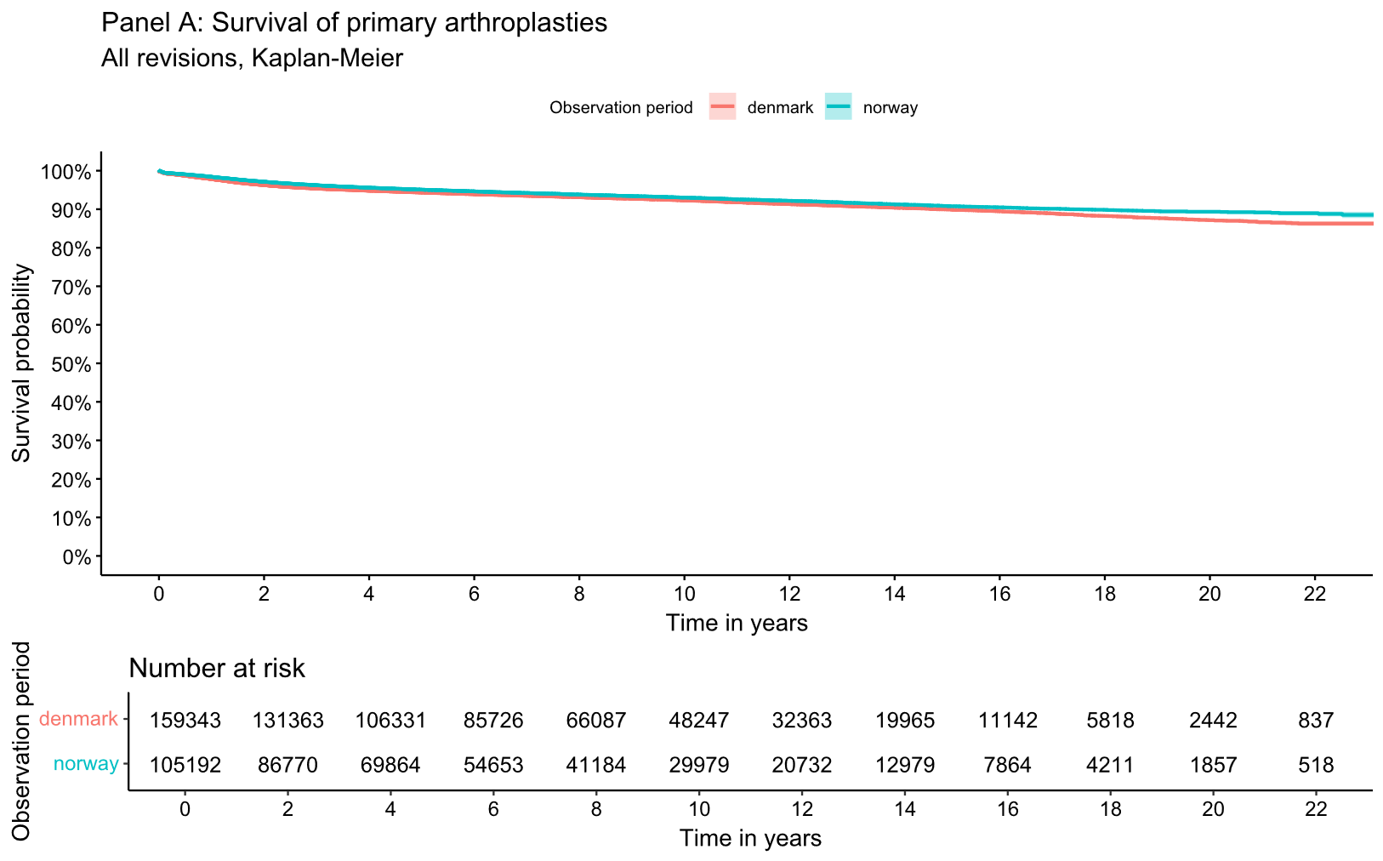
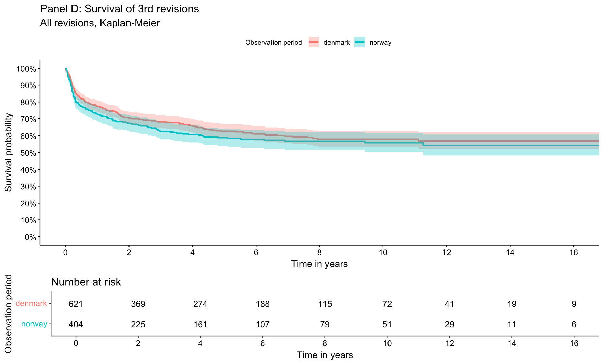
Similar incidence and implant survival of multiply revised knee arthroplasties in Norway and Denmark
J.T. HALD¹, A.M. FENSTAD², A.B. EL-GALALY¹, A. ODGAARD^{1,3}, O.N. FURNES^{2,4}
¹Dept. of Orthopedic Surgery, Rigshospitalet, Denmark; ² The Norwegian Arthroplasty Register, Haukeland University Hospital, Bergen, Norway; ³ Dept. of Clinical Medicine, University of Copenhagen, Denmark; ⁴ Dept. of Clinical Medicine, University of Bergen, Norway
CONTACT INFORMATION
RESULTS
Presented by Louise Ida Eggers Østergaard Rasmussen, MD
Corresponding author, Julius Tetens Hald, MD, PhD, email: julius.tetens.hald@regionh.dk
Incidence of revisions
Denmark |  |  | Norway |  | Differenceª [95% CI, p-value]
 | Revisions, n | % of primary procedures | Revisions, n | % of primary procedures
1st | 10,544 | 6.6% (10,544/159,343) | 5,980 | 5.7% (5,980/105,192) | 0.9% [0.7 to 1.1%, <0.001]
2nd | 2,129 | 1.3% (2,129/159,343) | 1,299 | 1.2% (1,299/105,192) | 0.1% [0.01 to 0.2, 0.03]
3rd | 621 | 0.4% (621/159,343) | 404 | 0.4% (404/105,192) | 0% [-0.04 to 0.05, 0.8]
4th | 222 | 0.1% (222/159,343) | 157 | 0.1% (157/105,192 | 0% [-0.04 to 0.02, 0.5]
ªTwo-proportion z-test
OBJECTIVES
The aim of our study was to identify the absolute incidence and implant survival probability of multiply revised knee arthroplasties in Norway and Denmark from 1998 to 2021.
METHODS
Where:
The Danish National Patient Registry
The Danish Knee Arthroplasty Register
The Norwegian Knee Arthroplasty Register
January 1st 1998 to December 31st 2021
What:
All primary knee arthroplasties in Denmark and Norway, including total-, uni-, and patellofemoral knee arthroplasties.
Revision defined as any exchange, removal, and/or addition of an arthroplasty component.
Two-stage revisions counted as two revision procedures.
Knee arthrodesis and femoral amputation not included.
How:
Absolute incidence (total count of events)
Kaplan-Meier methods
Cox regression with adjustment of age, sex and time of primary procedure
Survival of primary knee arthroplasties, Kaplan-Meier plot
Survival of 3rd revision knee arthroplasties, Kaplan-Meier plot
CONCLUSIONS
The incidence of multiply revised knee arthroplasties was similar in Norway and Denmark.
The implant survival of multiply revised knee arthroplasty patients decreased for each subsequent revision by similar amounts across Denmark and Norway.
In perspective, our study highlights the clinical difficulties associated with multiply revised knee arthroplasty patients who have poor implant survival after the first revision.
ACKNOWLEDGEMENTS
The study was funded by Rigshospitalets Forskningspulje, Sundhedsdonationer.dk, Copenhagen University, Aase and Ejnar Danielsens Fond, William Demant Fonden, Gehejmeråd P. Hersleb Classens Rejsestipendium for Læger, and Carl and Ellen Hertz’s Science Grant.

