Slide 1
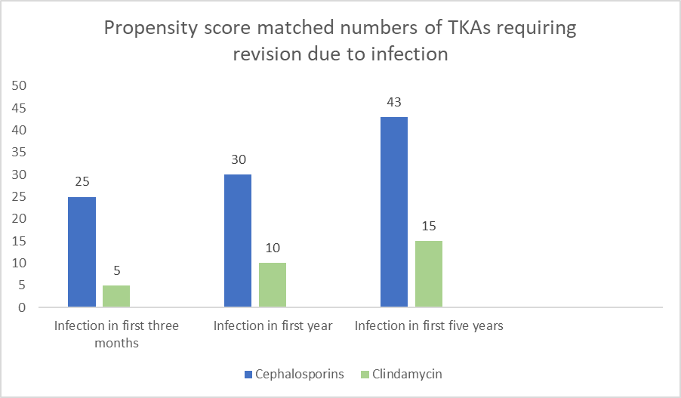
No difference in risk of revision due to infection between clindamycin and cephalosporin as antibiotic prophylaxis in cemented primary total knee replacements
A report from the Norwegian Arthroplasty Register 2005-2019
Karola Pawloy¹, Anne Marie Fenstad², Tesfaye Leta², Geir Hallan², Jan-Erik Gjertsen², Havard Dale², Stein Atle Lie² and Ove Furnes²
1. Aberdeen Royal Infirmary, Aberdeen, Scotland
2. The Norwegian Arthroplasty Register, Department of Orthopaedic Surgery, Haukeland University Hospital, Bergen, Norway
Introduction
Systemic antibiotic prophylaxis with clindamycin has earlier been associated with a higher risk of surgical revision for deep infection than cloxacillin in primary total knee arthroplasty (TKR).¹ This study investigates if clindamycin, the drug of choice in penicillin allergic patients, increases the risk of surgical revisions due to deep infection compared to cephalosporins in primary cemented TKRs.
 | Group 1 (Cefalotin, Cefazolin) | Group 2 (Clindamycin) | Group 1 (PSM 1:3)
Procedures, n (%) | 41,698 (96) | 1,806 (4.2) | 5,418
Revisions, n (%) | 1,924 (4.6) | 72 (4.0) | 236 (4.4)
Revisions due to infections, n (%) | 520 (1.2) | 16 (0.9) | 47 (0.9)
Deaths, n (%) | 5,920 (14) | 180 (10) | 742 (14)
Median FU (IQR) | 5.3 Years (IQR 2.6, 9.0) | 4.3 Years (IQR 2.0, 7.0) | 5.3 (2.6, 9.0)
Bilateral TKR, n (%) | 7,207 (17.3) | 334 (18.5) | 937 (17.3)
Male, n (%) | 16,085 (39) | 477 (25) | 1,341 (25)
Age, mean (SD) | 69 (9.6) | 68 (9.7) | 68 (9.6)
Diagnosis, n (%)
Osteoarthritis | 37,334 (90) | 1,627 (90) | 4,881 (90)
Other | 4,319 (10) | 179 (9.9) | 537 (9.9)
ASA class^{b} n (%)
ASA class 1 | 5,360 (13) | 144 (8) | 432 (8.0)
ASA class 2 | 27,616 (66) | 1,200 (66) | 3,600 (66)
ASA class 3+ | 8,722 (21) | 462 (26) | 1,386 (26)
ªPSM: Propensity score matching ^{b}ASA class: American Society of Anaesthetics
Results
43,495 TKRs were included of which 536 knees (1.2%) were revised due to deep infection. 520 of these had received cephalosporins and 16 clindamycin for perioperative prophylaxis. No statistical difference in hazard rate ratios (HRRs) due to infection between clindamycin and cephalosporins was found at 3 months, (HRR= 0.49 95% CI 0.2-1.18), 1 year (HRR=0.72, CI 0.38-1.35) or 5 years (HRR=0.79, CI 0.47-1.32). After propensity score matching, still no differences were found. Furthermore, no differences in risk for revision due to deep infection were found between cefalotin and cefazolin at 3 months or 1-year post-op.
Methods
This study was based on data from the Norwegian Arthroplasty Register (NAR) from the years 2005-2019. A total of 43,504 prostheses were included, 1,806 (4.2%) used Clindamycin. Only knees with antibiotic loaded bone cement were included. Cox regression analyses were performed with adjustment for sex, diagnosis and ASA score. A separate analysis using propensity score matched (PSM) datasets was performed. TKR survival probabilities with revision due to deep infection were compared between patients who had received cephalosporins and clindamycin as antibiotic prophylaxis. Survival probabilities were calculated using Kaplan-Meier estimates.
Conclusion
This observational study found no association between risk of revision surgery due to deep infection and choice of either cephalosporins or clindamycin as infection prophylaxis in primary TKRs. Furthermore, no differences in risk for revision due to deep infection were found between cefalotin and cefazolin at 3 months or 1-year post-op
1. Robertsson O, Thompson O, W-Dahl A, et al. Higher risk of revision for infection using systemic clindamycin prophylaxis than with cloxacillin. Acta orthopaedica 2017;88:562-7 doi:10.1080/17453674.2017.1324677.
Image: Knee replacement Illustrations and Clipart. 328 Knee replacement royalty free illustrations, and drawings available to search from thousands of stock vector EPS clip art graphic designers. (canstockphoto.com)

